Slide 1
Intercultural competence

Slide 2
Content
Introduction
What is intercultural competence ?
Importance of intercultural competence
Constituent elements of intercultural competence
Developmental model for intercultural sensitivity
Three stages of perception of a foreign culture
Process model with 4 competence realized in an intercultural context
Theories of intercultural competence
Factors relating to the individual's skills for cultural competence
Conclusion

Slide 3
Introduction
Intercultural competence is a valuable asset in an increasingly globalized world where we are more likely to interact with people from different cultures and countries who have been shaped by different values, beliefs and experiences.

Slide 4
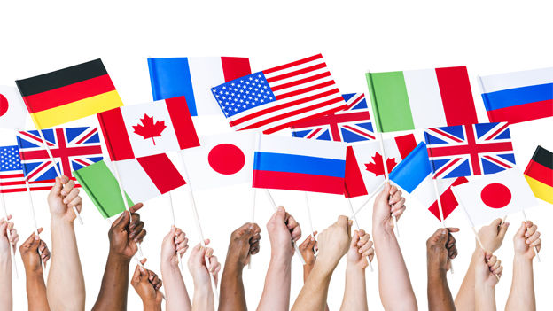
What is intercultural competence ?
Intercultural competence is a range of cognitive, affective and behavioral skills that lead to affective and appropriate communication with people from different cultural backgrounds – at home or abroad.

Slide 5
Importance of intercultural competence
Humanity have never been as connected as right now and on daily basis people deal with each other from all over the world. All of us are different. When we are in an unfamiliar environment and we have to understand why the behavior of the person in front of us is different than that you expect. Intercultural competence gives you tools and frameworks to better our understanding of other people and finally to become sensitive.

Slide 6
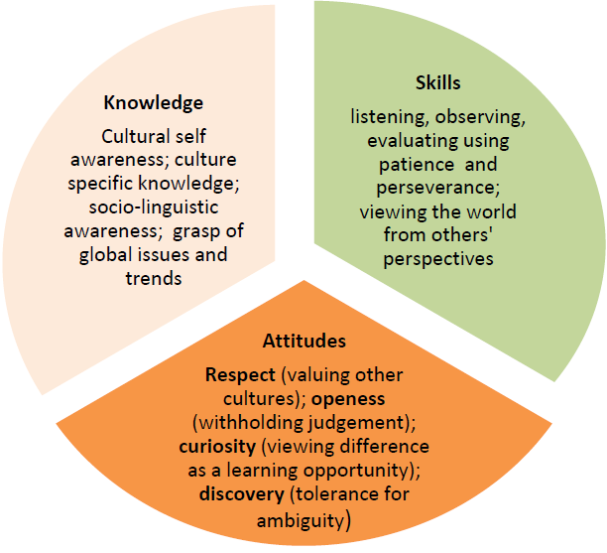
Constituent elements of intercultural competence

Slide 7
Developmental model for intercultural sensitivity
Denial
Defense
Minimization
Acceptance
Adaptation
Integration
Intercultural
Monocultural

Slide 8
Three stages of perception of a foreign culture
1. «Honeymoon»
When people enter an intercultural environment, they are optimistic and confident in successful communication and interaction, are fond of cultural values, interesting customs etc.

Slide 9
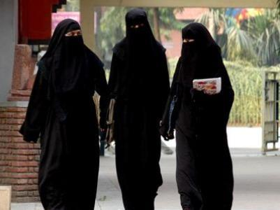
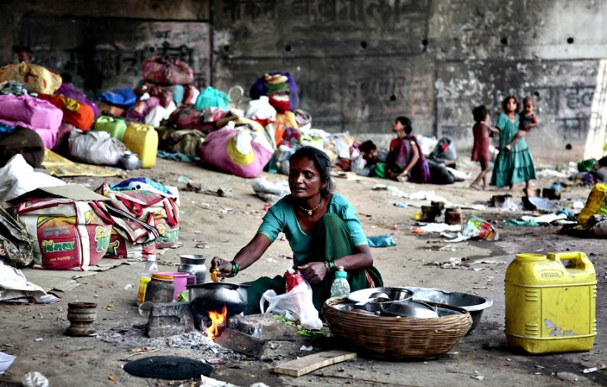
2. «Cultural shock»
When the positive mood is replaced by the depressive, hostility and uncertainty appear. The shock arises at the emotional level, social factors also play an important role: lack of adaptation and misunderstanding of new customs, behavior and style of communication, rhythm of life, material differences.

Slide 10
3. Adaptation
Forming a realistic assessment of the situation, the emergence of an adequate understanding of reality, the successful realization of personal goals.
OR
Escape
Complete rejection and denial of the new culture and the inevitable escape both in a figurative sense ("close in itself") and in a direct, physical sense.

Slide 11
Process model with 4 competence realized in an intercultural context
Professional (job knowledge, working experience)
Strategic (organizational skills, problem solving, decision making, knowledge management)
Social (adaptability, capacity for teamwork, empathy, tolerance etc.)
Individual (optimism, willingness to learn, resistance to stress and frustration, tolerance of ambiguity)

Slide 12
Theories of intercultural competence
Anxiety Uncertainty Management theory
The ability to be mindful and the effective management of anxiety caused by the uncertainty in intercultural interactions are key factors in achieving intercultural competence.
Face Negotiation theory
Proposes that all people try to maintain a favorable social self-image and engage in a number of communicative behaviors designed to achieve intercultural competence. Competence is identified as being part of the concept of “face,” and it is achieved through the integration of knowledge, mindfulness, and skills in communication.

Slide 13
Factors relating to the individual's skills for cultural competence
Intercultural communication

Slide 14
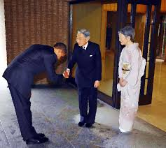
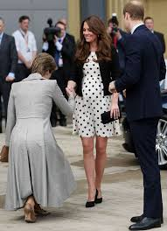
Display of respect

Slide 15
Empathy

Slide 16
Interaction management
It means taking initiative, taking turns during conversation and knowing how to talk to other appropriately and effectively including local communication formalities, watching change in the body language etc.

Slide 17
Task role behavior
It leads to group harmony, teamwork and productivity.

Slide 18
Relational role behavior
It is personal relationship that is trusting, harmonious and supportive to each other.

Slide 19
Tolerance for ambiguity

Slide 20
Orientation in knowledge
It means determining where people come from and understand their way of thinking and behavior.

Slide 21
Emotional expression and interaction posture
Expression of emotions in social behavior from culture to culture.

Slide 22
Conclusion
Intercultural competence describes the ability to understand other cultures and interact and work successfully both within and across them. This quality is far from
universal, but increasingly vital in our globalizing world. Organizations within the public and private sector would benefit from increased understanding of intercultural competence, as well as
methods for recognizing and fostering it.

Slide 23
Thank you your attention!

